Slide 1

College Student Life Advice
By Emiliano Sanchez and Kevin White

Slide 2
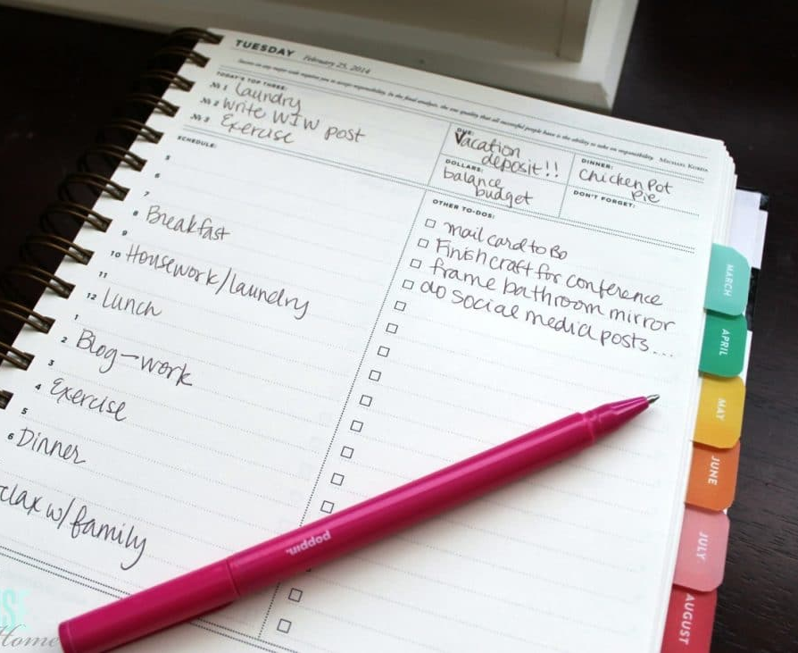
Plan Your Days!
As a student you are often not only in a new environment, but you also have more responsibilities. Make a planner to help organize your classes or work schedule, and take advantage of premade calendars like on Blackboard to notify yourself with due-dates and upcoming assignments
This Photo by Unknown Author is licensed under CC BY

Slide 3

Fix It Fast!
As soon as you have a problem in your home, whether it be the AC, bugs, or pipeline issues, get it fixed ASAP before it gets worse. The dorms will charge you if the problem is bad enough, but putting in a work order is free, take advantage of it before it’s too late!
This Photo by Unknown Author is licensed under CC BY-SA

Slide 4

Pay Off Loans Fast!
If you need to take out loans pay them off faster and cheaper by paying more every month, this will allow you to eat away at the loan and lower the increase in interest every month and ultimately save you more money in the long run

Slide 5

Make New Friends!
College is going to be a very important transitional phase for most people! It is very important to be involved with everyone around you and try make friendships that will last you a lifetime! There are many different clubs, so it is highly likely to meet somebody that has the same interests you do.
This Photo by Unknown Author is licensed under CC BY-ND

Slide 6

Work Around YOUR Schedule!
Class times are very expendable, choose classes that match around your internal clock. If you are more of a night owl than a morning bird, don’t try and strain your mind by choosing an AM class! This goes vice versa as well; all people are built to think differently.

Slide 7

Find New Hobbies!
College is a very crucial time to explore new and creative things in a different environment! Try to find something you’ve been interested in doing for a long time and see if you like it. Maybe you’ll find something that you can see yourself doing in the long run?

Slide 8

Keep Up with Work!
It’s not good to fall behind on schoolwork! Make sure to constantly check your calendar to see if there are updates on grades and assignments. If you’re unsure of what the work is, send an e-mail to your professor or a fellow classmate.

Slide 9

Make Time to Study!
Make sure that you put time aside to study properly for exams and tests, or even if you’re just having difficulty with the curriculum. Having enough time to yourself to study really helps you get forward in your grades and assignments.

